Slide 1
Solving problems by searching

Slide 2

Quick Review
Definition of AI?
Turing Test?
Intelligent Agents:
  Anything that can be viewed as perceiving its environment through sensors and acting upon that environment through its actuators to maximize progress towards its goals.
  Described as a Perception (sequence) to Action Mapping: f : P* → A
  Using look-up-table etc.
Agent Types: Reflex, model-based, goal-based, utility-based, learning
Rational Action: The action that maximizes the expected value of the performance measure given the percept sequence to date

Slide 3
Outline
Problem-solving agents (PSA)
Problem types
Problem formulation
Example problems
Basic search algorithms

Slide 4
The Limitation of Reflex Agents
A direct mapping from states to actions
Reflex agents cannot operate in environments for which
  The mapping is too large to store
  Too long time to learn
Goal based agents can succeed by considering
  future actions and
  The desirability of their outcomes

Slide 5
Problem-solving agents (PSA)
It’s a goal-based agent
Decides what to do by finding sequences of actions that lead to desirable states.
Intelligent agents are supposed to adopt a goal and aim to satisfy so as to maximize the performance measure.

Slide 6
Problem-solving agents (2)
Goal formulation is the first step in problem solving
Goal formulation based on
  the current situation and
  the agent’s performance measure
The agent has to find out which sequence of actions will get to a goal state.
Agent needs to decide what sorts of actions and states are to be considered.

Slide 7
Problem-solving agents (3)
Problem formulation is the process of deciding what actions and states to consider, given a goal
Traveling agent - Unless the agent is very familiar and has the previous knowledge of the geography of destination, it cannot make proper decision to reach destination.
Therefore, we need to search for the possible sequences?

Slide 8
Problem-solving agents (4)
Given an agent with several unknown actions, the process of examining different possible sequences of actions that lead to states of known actions is called Search.
A search algorithm takes a problem as input and returns a solution in the form of an action sequence.
Once a solution is found, then the actions can be carried out known as execution

Slide 9
Problem-solving agents (5)
The complete process of an agent to solve the problems can be shown as “formulate, search, execute” design for the agent.
A simple problem solving agent
  Formulate a goal and a problem
  Search for a sequence of actions to solve the problem
  Execute the actions one at a time
  When complete, formulate another goal and continue
  Note that while executing the sequence, the agent ignores its percepts assuming that the solution it has will always work

Slide 10
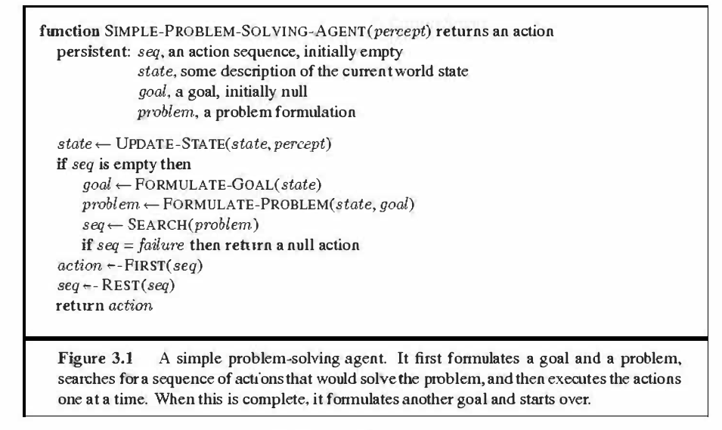
Problem-solving agents (6)
Note: UPDATE-STATE and FORMULATE-GOAL WILL BE DEFERRED

Slide 11
PSA: Environments
Static
  Formulating and solving the problem is done without paying attention to any changes that might be occurring in the environment
Observable
  Initial state is known; knowing it is easiest if the environment is observable
Discrete
  enumerating alternative courses of action assumes that environment can be viewed as discrete (finite number of actions)
Deterministic
  Solutions to problems are single sequences of actions (each action has exactly one outcome - no unexpected events)
  Solutions are executed without paying attention to the percepts
Note: The environment for PSA are easiest

Slide 12
Problem-Solving Agent
sensors
?
environment
agent
actuators

Slide 13
Problem-Solving Agent
sensors
?
environment
agent
actuators
Formulate Goal
Formulate Problem
  States
  Actions
Find Solution

Slide 14
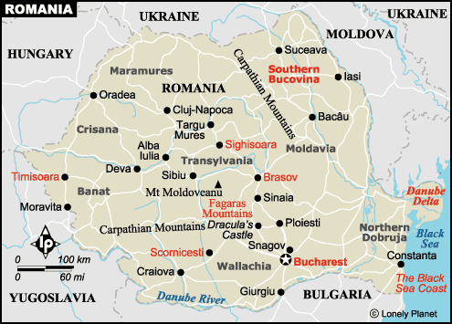
Example: Route finding

Slide 15

Example: Romania

Slide 16
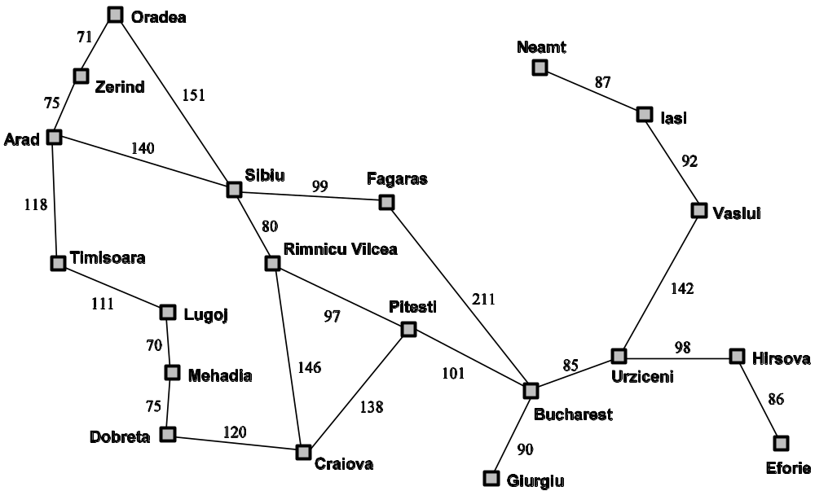
Problem Solving
States
Actions
Start
Solution
Goal

Slide 17
Example: Romania
On holiday in Romania; currently in Arad.
To reach Bucharest
Formulate goal:
  be in Bucharest
Formulate problem:
  states: various cities
  actions: drive between cities
Find solution:
  sequence of cities, e.g., Arad, Sibiu, Fagaras, Bucharest

Slide 18
State Space Search
State space is a set of legal positions.
Starting at the initial state.
Using the set of rules to move from one state to another.
Attempting to end up in a goal state.

Slide 19
Problem formulation
A problem is defined by five components:
Initial state e.g., “In (Arad)“
Actions
A description of the possible actions available to the agent
Given a particular state s, ACTIONS (s) returns a set of actions that can be executed in s.
We say that each of these actions is applicable in s.
Ex: from the state In (Arad), the applicable actions are
{ Go (Sibiu), Go (Timisoura), Go(Zerind) }

Slide 20
Problem formulation
A problem is defined by five components:
3. Transition Model:
A description of what each action does.
Transition model, specified by a function RESULT(s, a) that returns the state that results from doing action a in state s.
Also use the term successor to refer to any state reachable from a given state by a single action.
Example RESULT(In(Arad), Go(Zerind)) = In(Zerind)
STATE SPACE: Together, the initial state, actions, and transition model implicitly define the state space of the problem-the set of all states reachable from the initial state by any sequence of actions.

Slide 21
Problem formulation
A problem is defined by four components:
4. Goal test, can be
  explicit, e.g., x = "at Bucharest“
  Among the set of possible goal state(s), check whether the given state is one of them
  2. implicit, e.g., Checkmate(x) // in chess to capture the opponents king
  Goal is specified by an abstract property

Slide 22
Problem formulation
A problem is defined by four components:
5. Path cost (additive): A function that assigns a numeric cost to each path
PSA should choose a cost function that reflects its own performance measure
Ex: for the agent trying to go to Bucharest, the path cost is length in kms as time is involved
The path cost is assumed as the sum of the costs of the individual actions along the path
  Ex: sum of distances, number of actions executed, etc.
The step cost of taking action a to go from state s to state s’ is denoted as c ( s, a, s’) , assumed to be ≥ 0
Ex: The step costs for Romania are shown as route distances

Slide 23
Problem formulation
Five elements define a problem and can be represented as a single data structure that is given as input to a problem solving algorithm
A solution to a problem is a path (sequence of actions) from the initial state to a goal state
Solution quality is measured by the path cost function
An optimal solution has the lowest path cost among all solutions

Slide 24
A state space
The initial state and the successor function implicitly define the state space of the problem
State space – the set of all states reachable from the initial state
The state space forms a graph in which the
  Nodes are states
  Arcs between nodes are actions
A path in the state space is a sequence of states connected by a sequence of actions

Slide 25
Selecting a state space
Real world is absurdly complex.
  State space must be abstracted for problem solving.
Abstraction – the process of removing detail from a representation
Both state and actions are abstracted
Abstracting state description
  simple state description as In(arad) is considered not condition of the road, weather etc.
Abstracting actions
  Simple action of changing the location is considered rather than other driving actions such as consumes fuel, consumes time, generates pollution etc.

Slide 26
Selecting a state space
State = set of real states
Action = complex combination of real actions.
  e.g. Arad →Zerind represents a complex set of possible routes, detours, rest stops, etc.
The abstraction is valid if the path between two states is reflected in the real world.
Solution = set of real paths that are solutions in the real world.
Each abstract action should be “easier” than the real problem.

Slide 27
Applying problem solving
To a wide set of task environments
Simplest – Vacuum world

Slide 28
Example1: Vacuum World
Environment consists of two squares,
A (left) and B (right)
Each square may or may not be dirty
An agent may be in A or B
An agent can perceive whether a square is dirty or not
An agent may move left, move right, suck dirt (or do nothing)

Slide 29

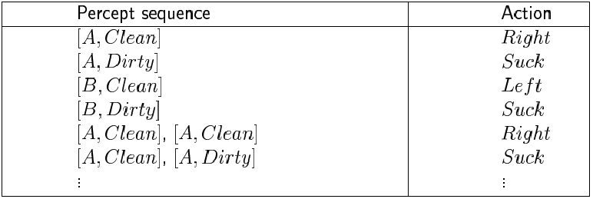
Vacuum-cleaner Problem
Percepts: location and status , e.g., [A,Dirty]
Actions: Left, Right, Suck, NoOp
Partial Tabulation of agent function

Slide 30
Vacuum-cleaner Problem
function REFLEX-VACUUM-AGENT ([location, status]) return an action
if status == Dirty then return Suck
else if location == A then return Right
else if location == B then return Left

Slide 31
Vacuum world Problem Formulation
Initial state: configuration describing
  location of agent
  dirt status of A and B
  Any state can be designated as the initial state
Actions or Successor function
  Generates the legal states that result from the 3 actions
  R, L, or S, causes a different configuration
Transition model: the complete state space graph
Goal test
  Check whether all squares are clean
Path cost
  Each step costs 1, so the path cost is the Number of steps (actions) in the path

Slide 32
Vacuum world Problem
States
The agent is in one of 2 locations, each of which might or might not contain dirt
So, there are possible 2x 2² possible states

Slide 33

Vacuum world Problem
States
2* 2 combinations ( 2 locations, 2 status- dirty or clean)
      A dirty, B dirty
      A dirty, B clean
      A clean, B dirty
      A clean, B clean

Slide 34
Vacuum world Problem
States
2 possible locations for agent –
    Agent in A with below 4 combinations
      A dirty, B dirty
      A dirty, B clean
      A clean, B dirty
      A clean, B clean
    Agent in B with below 4 combinations
      A dirty, B dirty
      A dirty, B clean
      A clean, B dirty
      A clean, B clean
So, there are 8 states

Slide 35
State Space
2 possible locations
x
2 x 2 combinations
( A is clean/dirty,
B is clean/dirty )
=
8 states
For n locations
n * 2^{n} states

Slide 36
Sample Problem
Initial State: 2
Action Sequence:
Suck, Left, Suck
(brings us to which state?)

Slide 37

States and Successors

Slide 38
Vacuum world state space graph - Summary
Arcs denote actions { L, R, S}
states? dirt and agent location
actions? Left, Right, Suck
goal test? no dirt at all locations
path cost? 1 per action

Slide 39

Example2: The 8-puzzle
states?
actions?
goal test?
path cost?

Slide 40
Example: Eight Puzzle
States:
  State description specifies the location of the eight tiles and location of the blank tile in one of the nine squares
Actions:
  Generates the legal states that result from trying the four actions {blank moves Left, Right, Up, or Down}
Goal Test:
  Checks whether the state matches the given goal configuration
Path Cost:
  Each step costs 1
  So, path cost is the number of steps in the path
7 | 2 | 4
5 |  | 6
8 | 3 | 1
1 | 2 | 3
4 | 5 | 6
7 | 8

Slide 41
Example: Eight Puzzle
What are abstractions here?
Details of physical manipulations are avoided
There are no actions such as
  Shaking the board, if pieces get stuck
  Extracting the pieces with a knife
7 | 2 | 4
5 |  | 6
8 | 3 | 1
1 | 2 | 3
4 | 5 | 6
7 | 8

Slide 42
Example: 8-puzzle
8
2
1
2
3
3
4
7
4
5
6
5
1
6
7
8
Initial state
Goal state

Slide 43
Example: 8-puzzle
8
2
7
3
4
8
2
5
1
6
3
4
7
5
1
6
8
2
8
2
Initial state
3
4
7
3
4
7
5
1
6
5
1
6

Slide 44
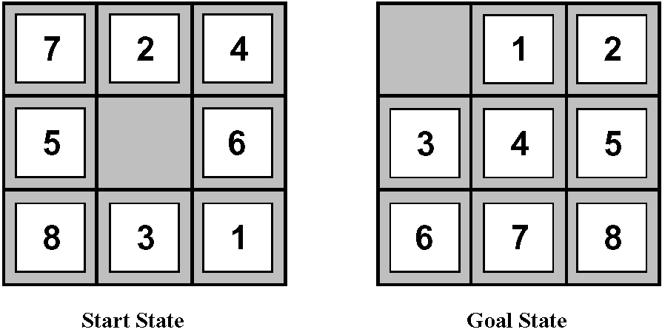
Example: 8-puzzle
State: Specification of each of the eight tiles in the nine squares (the blank is in the remaining square).
Initial state: Any state.
Successor function (actions): Blank moves Left, Right, Up, or Down.
Goal test: Check whether the goal state has been reached.
Path cost: Each move costs 1. The path cost = the number of moves.
Examples:
S(0)= {7, 2, 4, 5, 0, 6, 8, 3, 1}
S(n)= {0, 1, 2, 3, 4, 5, 6, 7, 8}
Where S(0) is the initial state
S(n) represent goal state
2
8
3
1
2
3
1
6
4
8
4
7
5
7
6
5
Start State
Goal State

Slide 45
Example: 8-puzzle
Blank moves left, right, up or down
Here, blank moves left, right, or up
2
8
3
1
2
3
1
6
4
8
4
7
5
7
6
5
Start State
Goal State

Slide 46
Expanding 8-puzzle
2
8
3
S(0)= {2, 8, 3, 1, 6, 4, 7, 0, 5}
1
6
4
7
5
Blank moves left
Blank moves right
Blank moves up
2
8
3
2
8
3
2
8
3
1
6
4
1
4
1
6
4
7
5
7
6
5
7
5
S(1)= {2, 8, 3, 1, 6, 4, 0, 7, 5}
S(1)= {2, 8, 3, 1, 6, 4, 7, 5, 0}
S(1)= {2, 8, 3, 1, 0, 4, 7, 6, 5}

Slide 47
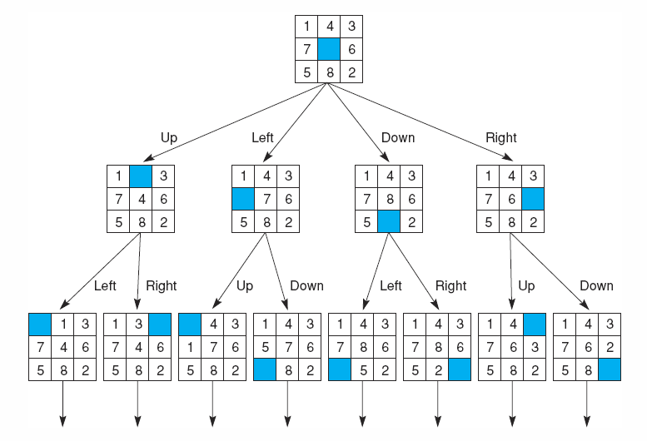
Expanding 8-puzzle

Slide 48
Example: Eight Puzzle
Eight puzzle is from a family of “sliding –block puzzles”
  Used as test problems for new search algorithms in AI
  NP Complete class
  8 puzzle has 9!/2 = 181440 states
  15 puzzle has approx. 1.3*10¹² states
  24 puzzle has approx. 1*10²⁵ states

Slide 49
Show the steps from Start state to goal state
Ex1:
2
8
3
1
2
3
1
4
8
4
7
6
5
7
6
5
Start State
Goal State

Slide 50
Show the steps from Start state to goal state
Ex2:
1
2
3
1
2
3
4
8
4
5
6
7
6
5
7
8
Start State
Goal State

Slide 51
Show the steps from Start state to goal state
Ex3:
1
2
3
1
2
3
4
5
8
4
5
6
6
7
7
8
Start State
Goal State

Slide 52
Example3: Eight Queens
Place eight queens on a chess board such that no queen can attack another queen
A queen attacks any piece in the same row, col or diagonal
Efficient algorithms exist for whole n-queens family
Still, an interesting test problem for search algorithms
Q
Q
Q
Q
Q
Q
Q
Q

Slide 53
Example: Eight Queens
Incremental formulation
Involves operators that augment the state description
Starting with an empty state
For 8-queen problem, each action adds a queen to the state
Complete state formulation
Starts with all 8 queens on the board
Moves them around
In both cases, no path cost because only the final state counts!
Q
Q
Q
Q
Q
Q
Q
Q

Slide 54
Example: Eight Queens
Incremental formulation
States:
  Any arrangement of 0 to 8 queens on the board
Initial state:
  No queens on the board
Actions:
  Add a queen to an empty square
Transition Model:
  Returns the board with a queen added to the specified square
Goal Test:
  8 queens on the board and none are attacked
64*63*…*57 = 3*10¹⁴ possible sequences
Q
Q
Q
Q
Q
Q
Q
Q
→ 64⁸ states with 8 queens

Slide 55
Example: Eight Queens
An improved formulation is to prohibit placing a queen in any square that is already attacked
States:
  Arrangements of n queens (n= 1 to 8), one per column in the leftmost n columns, with no queen attacking another are states
Actions:
  Add a queen to any square in the leftmost empty column such that it is not attacked by any other queen.
2057 sequences to investigate
Q
Q
Q
Q
Q
Q
Q
Q

Slide 56
Eight Queens
A huge reduction for the improved formulation
But still too big for algorithms of this chapter
Complete state formulation in Chapter 4 (not in syllabus)
A simple algorithm in Chapter 5 (upto alphabeta pruning)

Slide 57
Problem formulation
Formulating some important problems
And then solve the problems
This is done by a search through the state space
We deal with search techniques that use an explicit search tree in this chapter

Slide 58
Some Considerations
Environment ought to be static, deterministic, and observable
  Why?
If some of the above properties are relaxed, what happens?
Toy problems versus real-world problems

Slide 59
Real-world Problems
Route finding
Touring problems (TSP)
VLSI layout
Robot Navigation
Automatic assembly sequencing
Protein design
Internet searching
…

Slide 60
Example4: Route-finding
Given a set of locations, links (with values) between locations, an initial location and a destination, find the best route
States?
Initial state?
Actions?
Transition model?
Goal test?
Path cost?

Slide 61
Route-finding
The airline travel problems solved by a travel-planning Web site:
States: Each state includes a location (e.g., an airport) and the current time. Since the cost of an action (a flight segment) may depend on previous segments, their fare bases, and their status as domestic or international, the state must record extra information about "historical" aspects.
Initial state: This is specified by the user's query.
Actions: any flight from the current location, in a given seat class, leaving after the current time, leaving enough time for within-airport transfer if needed.

Slide 62
Route-finding
The airline travel problems solved by a travel-planning Web site:
Transition model: The state resulting from taking a flight will have the flight's destination as the current location and the flight's arrival time as the current time.
Goal test: Are we at the final destination specified by the user?
Path cost: This depends on monetary cost, waiting time, flight time, customs and immigration procedures, seat quality, time of day, type of airplane, frequent-flyer mileage awards, etc.

Slide 63
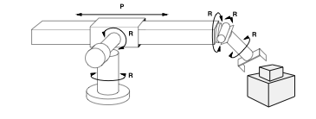
Example: robot assembly
States?? Real-valued coordinates of robot joint angles; parts of the object to be assembled.
Initial state?? Any arm position and object configuration.
Actions?? Continuous motion of robot joints
Goal test?? Complete assembly (without robot)
Path cost?? Time to execute

Slide 64
Basic search algorithms

Slide 65
Basic search algorithms
Having formulated some problems…how do we solve them?
  A solution is an action sequence
  Search the state space (remember complexity of space depends on state representation)
  Here: search through explicit tree generation (search tree)
    ROOT= initial state.
    Initial state and successor function together define state space
    Nodes and leafs generated through successor function.
  In general search generates a search graph (same state through multiple paths) rather than a search tree

Slide 66
Basic search algorithms
Searching through the state space
Search tree rooted at initial state
A node in the tree is expanded by applying each valid action
  Children nodes are generated with a different path cost and depth
Return solution once node with goal state is reached

Slide 67
General Tree search algorithm – informal description
Search strategy is the process of continuous choosing, testing, and expanding until a solution is found or there are no more states to be expanded.
The choice of which state to expand is determined by search strategy
An informal description of the general search algorithm

Slide 68
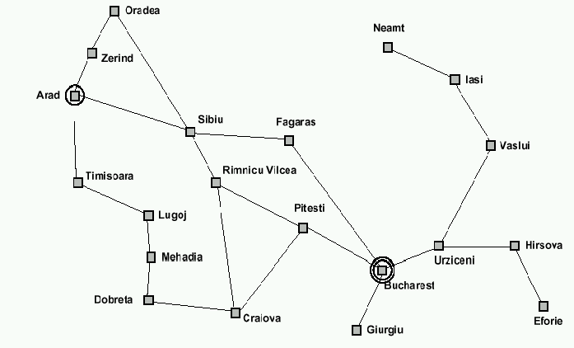
Breadth-first search: Traveling from Arad To Bucharest

Slide 69

Tree search example
Partial search tree is shown above for finding a route from Arad to Bucharest
The root of the search tree is a search node corresponding to the initial state In (Arad)
Check whether this is a goal state
If not, expand the current state
That is, by applying each legal action to the current state
This generates a new set of states - ln(Sibiu), ln(Timisoara), and ln(Zerind).

Slide 70

Tree search example
Partial search tree is shown above for finding a route from Arad to Bucharest
Suppose we choose Sibiu first.
Now check to see whether it is a goal state and then expand it
We get ln(Arad), ln(Fagaras), ln(Oradea), and ln(RimnicuVilcea).
We can then choose any of these four or go back and choose Timisoara or Zerind.
Each of these six nodes is a leaf node - Arad, Fagaras, Oradea, RimnicuVilcea, Timisoara or Zerind

Slide 71

Tree search example
Leaf node - a node with no children in the tree.
Frontier - The set of all leaf nodes available for expansion at any given point is called the frontier.
Frontier of each tree consists of those nodes with bold outlines.
The process of expanding nodes on the frontier continues until either a solution is found or there are no more states to expand.

Slide 72
Tree search example
Search strategy is the process of continuous choosing, testing, and expanding until a solution is found or there are no more states to be expanded
Partial Expansions in the search tree shown above
Shaded nodes – denote nodes that are expanded
Bold Outlined nodes – Nodes that have been generated but not yet expanded (fringe)
Faint dashed nodes – nodes that have not yet been generated

Slide 73
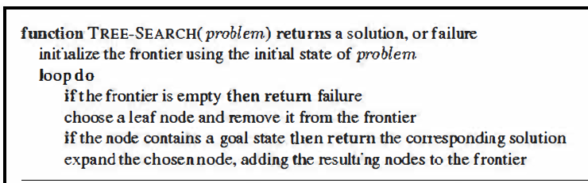
Informal Description of search tree Algorithm
Note: The algorithm stated above is actually called tree search. It will visit a state of the underlying problem graph multiple times, if there are multiple directed paths to it rooting in the start state. It is even possible to visit a state an infinite number of times if it lies on a directed loop. But each visit corresponds to a different node in the tree generated by our search algorithm.

Slide 74


